Slide 2
Northeastern Illinois University
Fulbright Scholar Program Opportunities

Slide 3
OVERVIEW
Presentation Overview
Introduction
Core Fulbright U.S. Scholar Program
Additional Fulbright U.S. Scholar Opportunities
Fulbright Visiting Scholar Opportunities

Slide 4
INTRODUCTION
The Fulbright Program
“We must try to expand the boundaries of human wisdom, empathy and perception, and there is no way of doing that except through education.”
— Senator J. William Fulbright
Notes:
Photo Caption: Left- Dr. Joseph Withey, Associate Professor of English, East Carolina College, Greenville, North Carolina, discussing a planned book on Burmese dancing and dramatics with Kenneth Sein, one of Burma's leading dancers, during his Fulbright Research Scholar grant from July 1960-June 1961. Right: Linda Chamerlain, Adjunct Professor at the University of Alaska and Director/Public Health Scientist, Alaska Family Violence Prevention Project, was a 2014-2016 Fulbright Arctic Scholar.

Slide 5
INTRODUCTION
The Fulbright Legacy
Established 1946 to expand and strengthen the relationships between the people of the United States and citizens of the rest of the world
Sponsored by U.S. Department of State’s Bureau of Educational and Cultural Affairs
Administered by the Institute of International Education’s Council for International Exchange of Scholars (CIES)

Slide 6
INTRODUCTION
Fulbright in Numbers
370,000+ Fulbrights awarded since 1946 800
U.S. Scholar grants annually
160
Participants countries
82
Pulitzer Prize recipients
58 Nobel Laureates 33
Heads of State or Government
31
MacArthur Fellows
16
Presidential Medal of Freedom recipients

Slide 7
INTRODUCTION
Fulbright Scholars are:

Slide 8
Fulbright U.S. Scholar Programs
Programs are active in over 125 countries for faculty, administrators and professionals
Core Fulbright U.S. Scholar Program - Annual competition; teaching and/or research; two to twelve months
Fulbright Specialist Program - Six deadlines per year; teaching and development; two to six weeks
Administrators and Seminar Programs - Annual competition; teaching, seminar, and/or research; vary from two week to two month exchanges

Slide 9
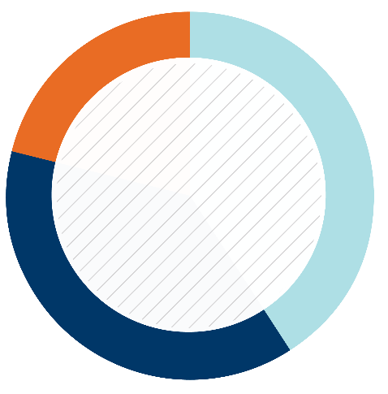
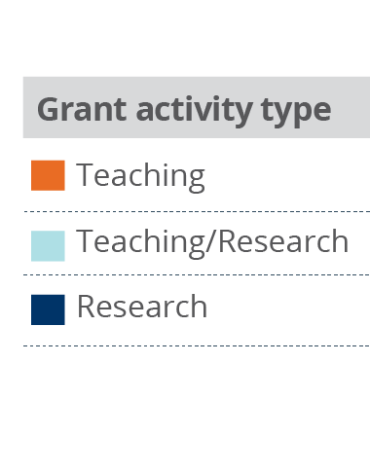
U.S. SCHOLAR PROGRAM
Core Fulbright U.S. Scholar Program
Supports teaching and/or research activity for three to 12 months
Programs active in +125 countries for faculty, administrators and professionals
Open to all disciplines
Apply to specific award with proposed project
Application deadline: August 1
Most hosts are higher education institutions
Eligible hosts vary by award, may include universities, research centers, institutes, laboratories, government offices, museums, etc.
21%
41%
Percentage of Scholars
2016-2017
38%

Slide 10
U.S. SCHOLAR PROGRAM
Fulbright Flex Awards
Flex Awards are designed for scholars who require multiple visits to the host country over short segments
Applicants must indicate plans for Flex in their project statement, including a project timeline
Flex grantees are especially encouraged to make contact with the local community, developing long-term connections and collaborations
Available in specific countries and regional awards
Consult the Catalog of Awards

Slide 11
U.S. SCHOLAR PROGRAM
Fulbright Global Scholar Award
Significant innovation for Fulbright
Project must include at least 2 separate world regions
Work typically in 2-3 different countries
2-3 segments over as much as 2 years
Topics must benefit from a global perspective
Specify
Why each country
What will be accomplished
When each country segment is planned

Slide 12
U.S. SCHOLAR PROGRAM
Review Process and Timeline
AUG.
Program staff conduct technical reviews for completeness
SEPT.
Discipline-specific committees review applications
SEPT. –
EARLY NOV.
U.S. peer review committees discuss applications for a single geographical region
NOV. – JAN..
Applicants notified of status - Recommended applications are sent to host countries and to the J. William Fulbright Foreign Scholarship Board
FEB. – MAY
Grantees notified of final approvals
MAY – JUNE
Grant packets sent to grantees

Slide 13
Selecting an Award
Awards in Catalog are created in the hosting country by the local Fulbright Commission or the American embassy
Search by Country and Regional listings
Search by Activity - teaching, research or both
Search by a specific Discipline or All Discipline
50% of grants are All Discipline awards
Read award descriptions and stipend information carefully
Contact CIES program officer(s) for more information about awards and countries

Slide 14
FULBRIGHT FAMILY
Other Fulbright Programs
Fulbright Specialist Program
Short term program that promotes linkages between U.S. scholars and professionals and their counterparts at host institutions overseas.
Fulbright U.S. Student Program
Recent graduates, postgraduate candidates through dissertation level, developing professionals and artists to study and research abroad
Fulbright Distinguished Awards in Teaching Program
Principally for primary- and secondary-level educators
Fulbright-Hays Awards
Faculty research, group projects and seminars in designated social sciences and humanities fields

Slide 15
Fulbright Specialist Program
Two- to six-week consulting and/or teaching opportunities that are flexible and fit the grantees’ commitments
Applicants are peer reviewed and placed on Fulbright Specialist roster for five years
Program does not support research
Twenty-four eligible disciplines, including STEM education fields
Institutions overseas create projects to strengthen and support their development needs with the aid of Specialists
Six application deadlines per year

Slide 16
Scholar-In-Residence Program
Brings scholars and professionals from abroad to campuses that do not often host visiting scholars
Involves colleges and universities that serve student populations underrepresented in international exchange programs
S-I-R grantees
Primarily teach undergraduates
Provide cross-cultural/international perspective
Application is made by the interested U.S. institution
1 semester or full academic year options
Deadline is OCTOBER 15

Slide 17
Outreach Lecturing Fund (OLF)
U.S. institutions apply and pay for lodging and meals
Travel grant for Fulbright Visiting Scholars already in the U.S. for short-term guest teaching
Meet with faculty and students to allow for an exchange of ideas
Meet with community organizations, professional, cultural or religious groups, K-12 schools and school districts that have a special interest in international relations.
View a list of 900+ scholars in country at: http://www.cies.org/fulbright-scholars

Slide 18
U.S. SCHOLAR PROGRAM
Fulbright Impact: Personal and Professional
Increased academic production
New technical knowledge and skills
Development of intercultural communication skills
Enhanced teaching skills and new methodologies
Published research (2015 survey of 2013-2015 grantees)
+60% of grantees published in peer reviewed journals
39% of grantees published books or book chapters
Access to an expansive network of Fulbright alumni around the world

Slide 19
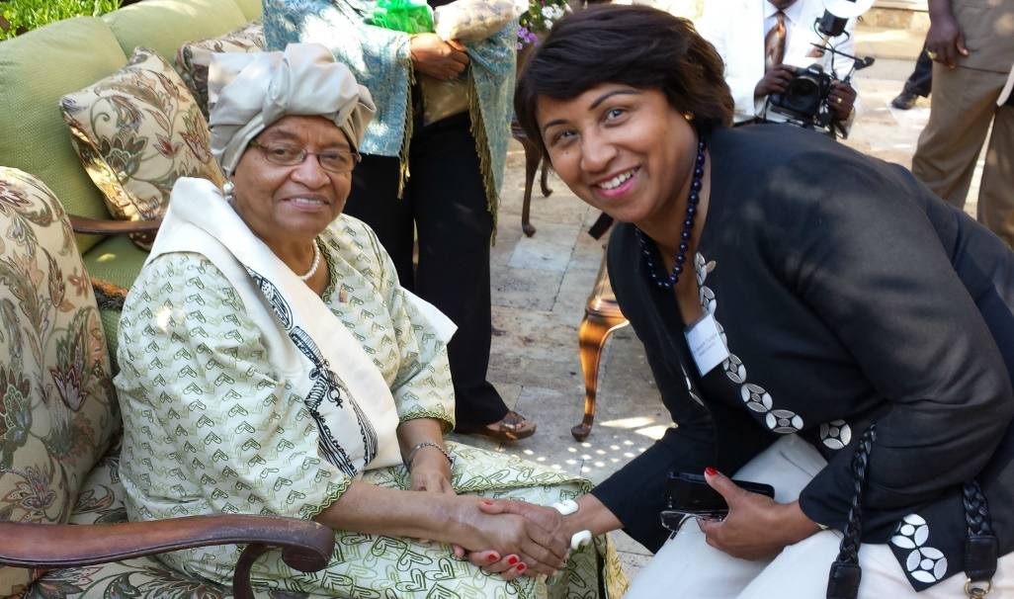
U.S. SCHOLAR PROGRAM
Fulbright Impact: Home Institution
Host institution gains new knowledge, new courses and new energy from scholar
Scholar’s collaborative relationship with host institution and colleagues in-country results in continued dialogue and exchange
Experience impacts scholar’s field, career, home institution and home community
Notes:
Photo Caption: Jeanne Toungara, Associate Professor of History at Howard University, had Fulbright-Hays award to Senegal and Côte d'Ivoire, where she researched indigenous ideologies and the cultural foundations of contemporary African politics.

