Slide 1


NEIU Tuition Payment Plan Tutorial

Slide 2
What is the NEIU Tuition Payment Plan?
The NEIU tuition payment plan is an interest-free, online, term-based monthly payment plan option that allows you to spread your payments over a set # of months during an academic term to make paying your tuition more affordable.
You must be registered for the upcoming term to enroll into the plan.
A non-refundable enrollment fee of $45.00 is due at sign-up.
You can enroll a prior term balance of $2,000 or less along with the new term balance into a plan.
Monthly payments must be auto-deducted from a saved payment method (bank account or credit card).
A fee of $25.00 will be assessed a late/missed monthly payment. If two consecutive monthly payments are missed, the plan will be canceled for non-payment.

Slide 3
Navigation to Payment Plan
Login to NEIUport
Go to the Student Payment Services card
Click the Payment/Refund link twice

Slide 4
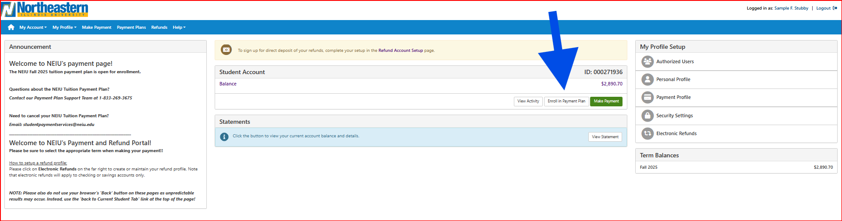
Enroll
Click Enroll in Payment Plan
Please Note: This is a demo to illustrate the enrollment steps. The dates/terms are all test data.

Slide 5
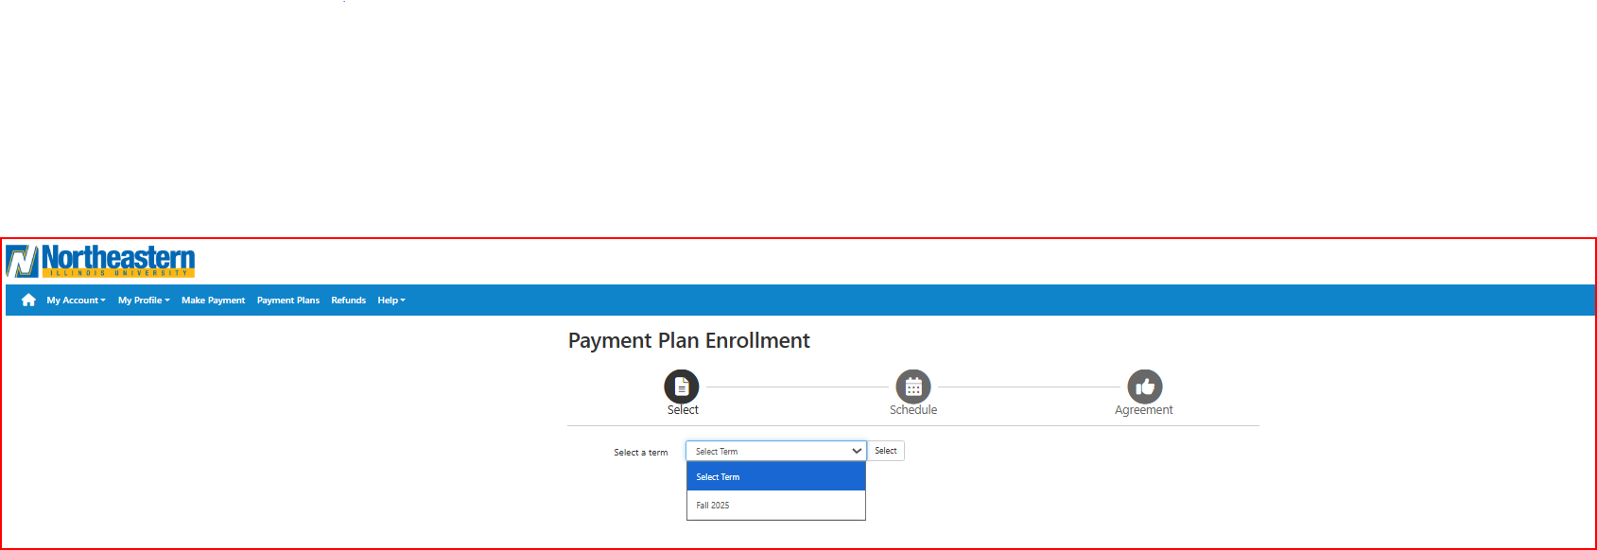
Select Term
Click the drop-down arrow, click the term, then click Select.

Slide 6
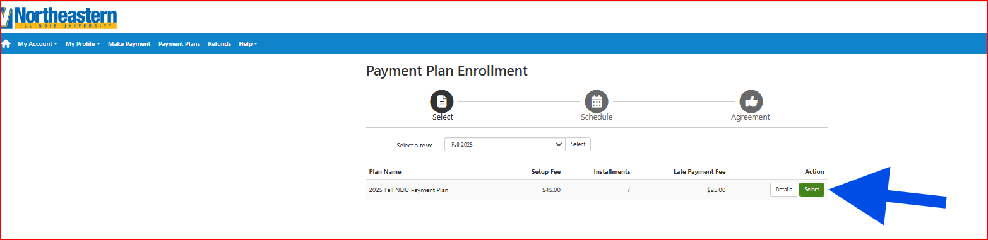
Select Plan
Click the Select button under Action

Slide 7
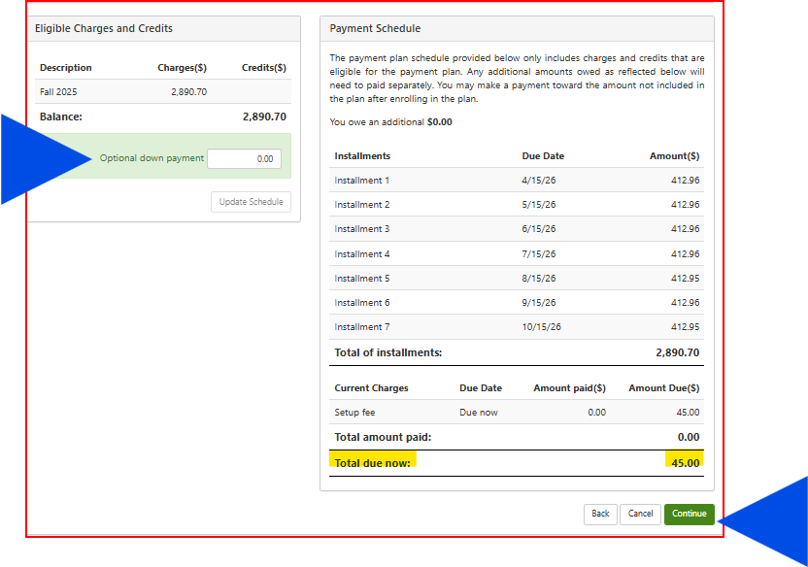
Optional: Down Payment
Down payments are optional and can be any dollar amount. The down payment and the $45.00 enrollment fee are due at enrollment.
Enter a down payment amount and click Update Schedule, then click Continue.
If you do not enter a down payment, you will only be charged the $45.00 non-refundable enrollment fee as shown below. Click Continue.

Slide 8
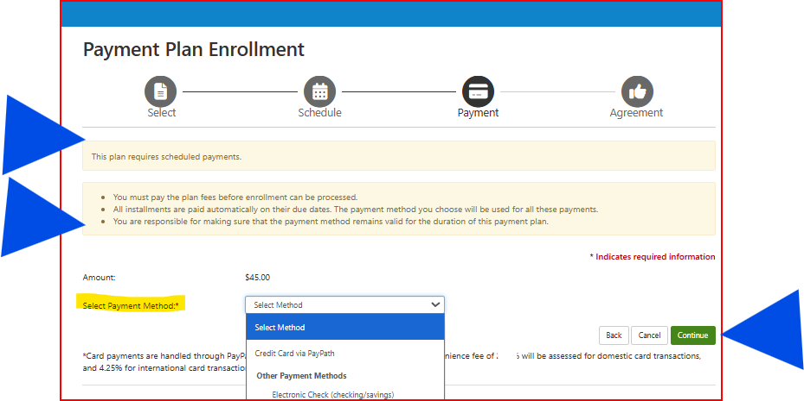
Select Payment Method
The demo payment in this tutorial will be an ACH (electronic check) transaction. If you choose to pay via credit card, you will be re-directed to Pay Path to make the card payment. A convenience fee of 3.00% will be assessed for domestic cards and 4.25% for international cards. No additional fees apply for electronic check payments.
Click the drop-down arrow to select a payment method, then click Continue.

Slide 9
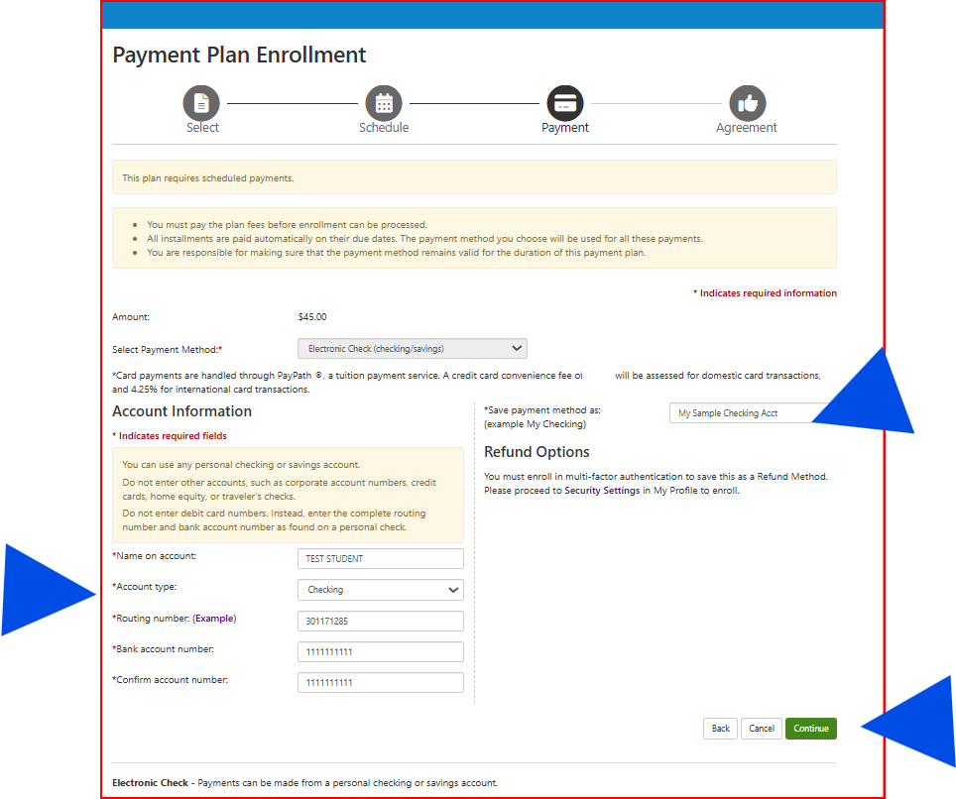
Account Information
Enter your account information, name your saved payment method, & click Continue.

Slide 10
TILA - Federal Truth in Lending Act Disclosures
TILA or Regulation Z requires lenders including schools and businesses offering payment plans to clearly disclose all credit terms if the plan involves more than (4) four installments or a finance charge.
The NEIU Tuition Payment Plan is an interest-free plan.
For more information about TILA please visit:
https://shorturl.at/wtc2X

Slide 11
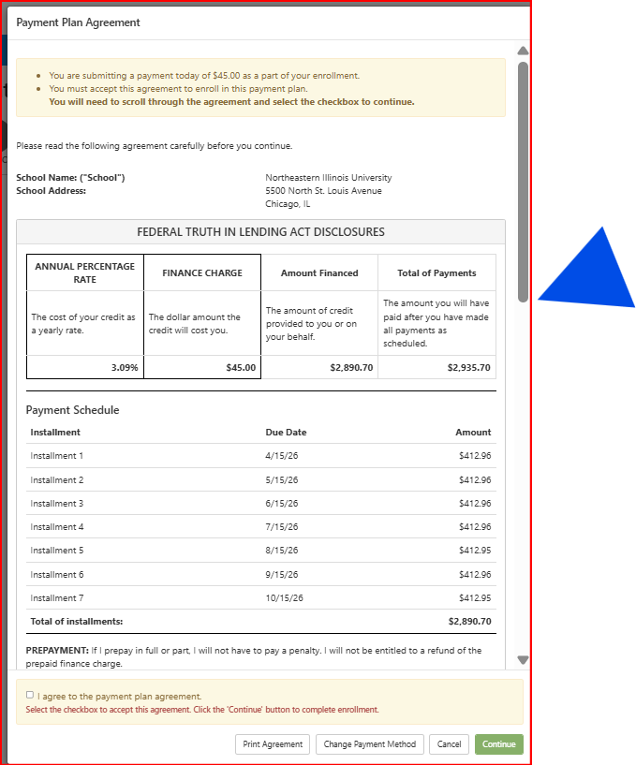
TILA - Federal Truth in Lending Act Disclosures (cont.)
Scroll to the end to review the entire document

Slide 12
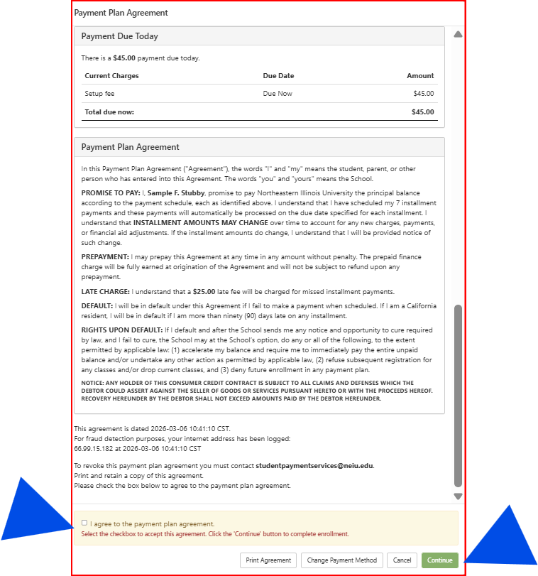
TILA - Federal Truth in Lending Act Disclosures (cont.)
Once you have scrolled through the document, check the box on the lower left to agree then click Continue.

Slide 13
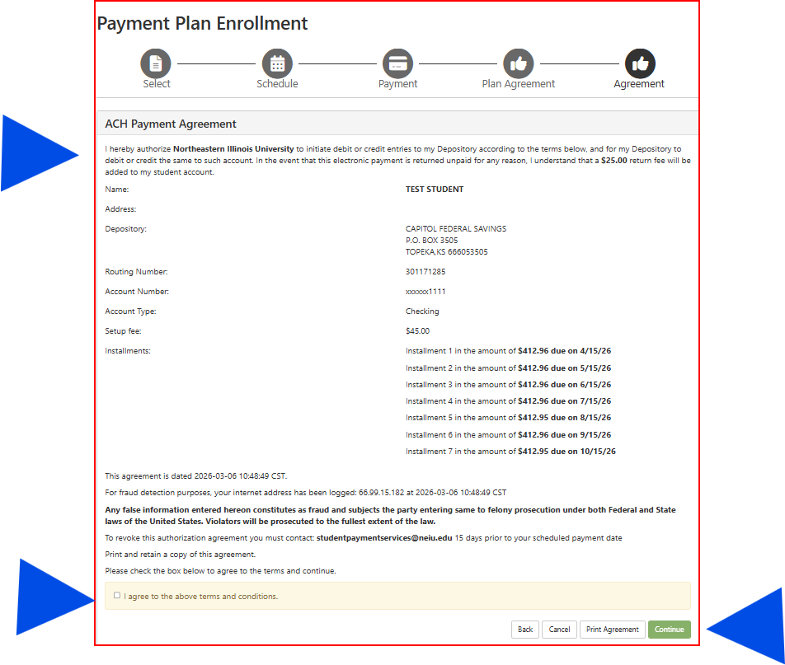
Terms and Conditions
Be sure to fully review the payment agreement, check the box to agree to the terms and conditions, and click Continue.

Slide 14
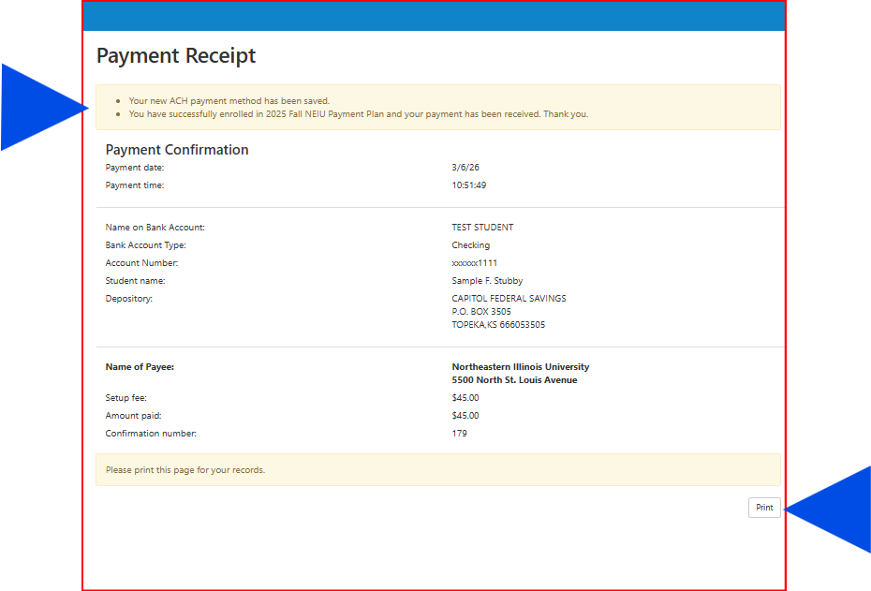
RECEIPT
This receipt verifies successful enrollment in the NEIU Tuition Payment Plan. An email notification will be sent to your NEIU student email account or to your authorized user’s email account.
You can also print the receipt for your records.

Slide 15
Plan Notifications
Once you are enrolled in a payment plan, notifications will be sent to your student email account or to your authorized user’s email account when changes/updates are made to the payment plan including:
Recalculations resulting from changes to your student account such as: add/drop of courses or financial aid awards/adjustments.
If you or your authorized user makes a change to the saved payment method on file.
A monthly payment installment is coming due, a payment is successfully made to your plan, or a payment was not successfully made to your plan.
A monthly installment is past due and the $25.00 late fee has been assessed.
If your plan is cancelled.

Slide 16
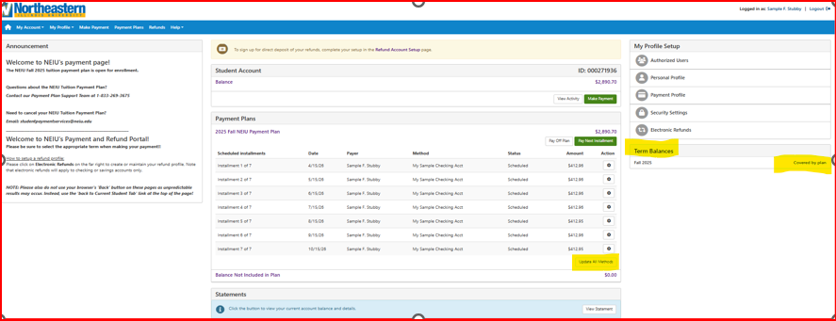
Account View after Enrollment
After you have setup a payment plan, this is how your account will appear when you login to NEIUport.
Here you can see the terms covered by the plan under Term Balances and, if necessary, you can update your payment methods.

Slide 17
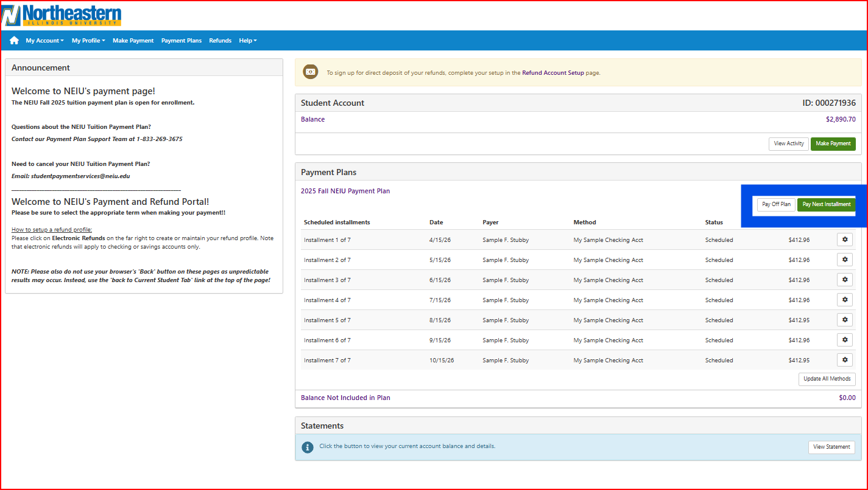
Pay Next Installment or Pay Off Plan
While monthly payments will be auto-deducted, you also have options to make early or additional payments to your plan, or to pay off your plan. Please follow the steps below:
To make an early or an additional payment, click Pay Next Installment so that the payment applies directly to the plan. This will ensure that your plan calculates correctly and stays in balance.
To pay off your plan click the Pay Off Plan button.

Slide 18
Need Support?
If you or your authorized user have questions or need assistance with plan enrollment, we are here for you.
↓
Call our payment plan support team @ 1-833-269-3675
Email studentpaymentservices@neiu.edu
Check out NEIU Tuition Plan Frequently Asked Questions (FAQs).

Slide 19

DON’T DELAY
ENROLL TODAY!!

